Slide 1

Management of Small Business
Kateryna Zaslavska
Associate Professor
of Management, Logistics and Economics Department
of Simon Kuznets Kharkiv National University of Economics

Slide 2
Task
Comparative characteristics of small and large business
 | Small Business | Large Business
Advantages
Disadvanages

Slide 3
Task
1. Describe the small business criteria in 3 countries
2. Analyze the ways of State support of small business in these countries

Slide 4
Task
1. Find the examples of successful and unsuccessful entrepreneurial ideas.
2. Analyze the reasons for the success or failure of the business concerned.
3. Choose any well-known product or service. Analyze which idea has become the basis for further business.

Slide 5
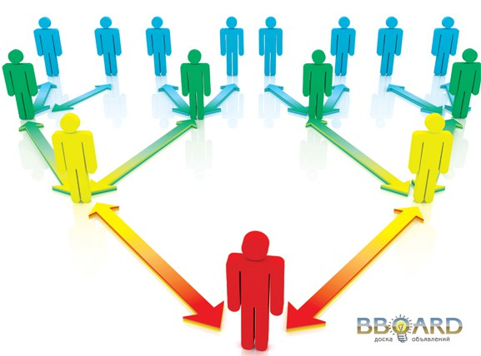
Organization Participants
Participants are groups
which have a potential or real impact
on organizational decisions
such as the choice of goals and actions.

Slide 6
For whose needs there are organizations?
Opportunity # 1 - for shareholders
This is a traditional sight. The owners of the organization invest (in fact risking) their money in the business, and while they receive a decent income from it, the company fulfills its task.
Opportunity # 2 - for customers
While the organization meets the needs of customers, it fulfills its main function.
Opportunity # 3 - for employees
Instead of treating people as another type of material used in production, many companies believe that their most important goal is to meet the needs of employees. In this case, the following equations are considered valid:
Unsatisfactory staff = low productivity, complications, strikes.
Satisfied employees = high productivity, peace and harmony, prosperity.
Opportunity # 4 - for managers
Managers are also employees, they can also be shareholders and customers. This view exists because managers are people who have power in organizations (they make decisions) and want to fully meet their needs. According to this view, the organization exists for them: not only for "top management", but for all managers. *
Opportunity # 5 - for everyone who is associated with the company
And why not try to meet the needs of all people associated with the functioning of the company? Not only shareholders, managers, employees, customers, but also the whole part of society whose life is somehow connected with the activities of the organization, the so-called "stakeholders“
* John Kennet Galbreit

Slide 7
«An enterprise in the field of business is obliged to add to its fundamental concern for the quantitative parameters of life (about goods and services) the care of the quality of life, the physical, humanitarian and social environment of modern people and modern society».*
Peter Druker
The company's goal is to obtain high profits to meet the needs of shareholders, and other stakeholders and issues of social responsibility are the factors contributing to the achievement of the main goal
The purpose of the business is to ensure that the company performs a social function by meeting the needs of all stakeholders

Slide 8
Factors that interfere with goal setting
Each participant has a significant influence on the organization;
Each participant seeks to maximize his own interest and perceives the interests of others as incompatible with his own;
Participants change what they expect to have from the organization;
A team of managers is divided into competitive groups within the organization.

